Slide 1

Workout Planner
By
Eoghan Winters

Slide 2
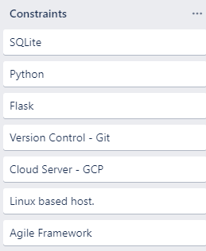
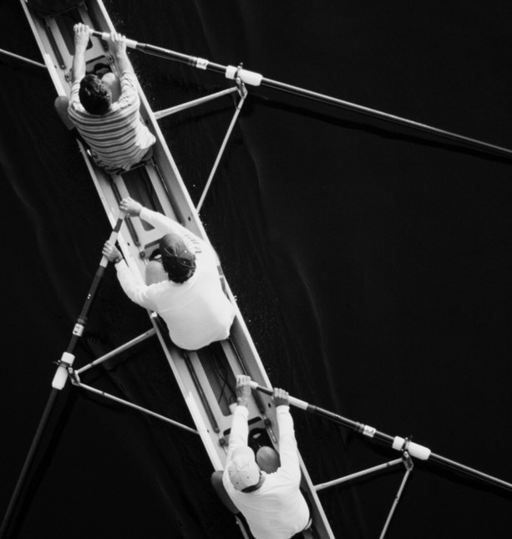
Project Brief
Create a full CRUD application following the constraints given in the picture to the left, taken from the Trello board.
The application must have a relation database to store data.
Application must be developed in Python.
Version control must be used throughout to show progress and also allow for consistent backups of work completed.

Slide 3

About The Application
A full CRUD workout planner application was built to allow user to do the following;
Register/log-in
Edit account information
Create an exercise to add to their workout
Add details for each exercise
Search through existing exercises
Update existing exercises
Delete exercises

Slide 4
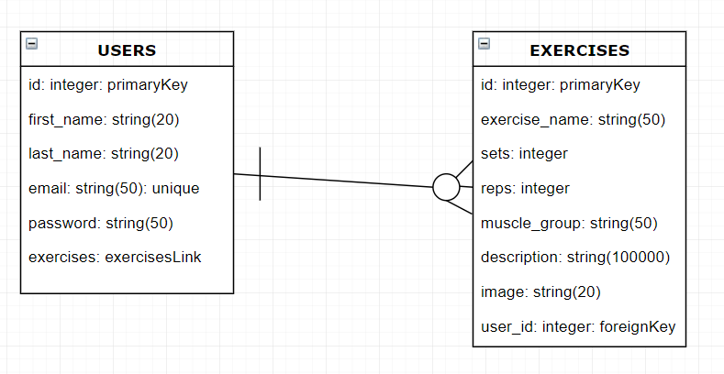
Database Entity Diagram

Slide 5
Why did I choose the application?

Slide 6

Live Demo

Slide 7
What tech was used?
Flask
Git
GCP
Flask was used for the project as it is a python framework.
Flask allows for only necessary modules to be imported.
The template engine Jinja2 also was used for implementing python functions throughout the application.
Git was used for version control when building the application to allow for consistent updates to the source code.
GitHub was used as the UI for Git and allowed me to view all files within the master and testing branches clearly.
GCP was used to deploy the application as it allowed for access from any browser.
This saved time for the presentation by eliminating the trouble of having to setup a VM and run the application on the local host.
GCP was ideal for the application due to its ability to scale based on demand in the event of unexpected traffic.

Slide 8
Problems Encountered
Three of the main problems encountered when developing the application include;
When transferring the application on to a GCP instance, I encountered problems with deployment. The application was reacting differently between browsers. Updated CSS fixed this.
Updating descriptions for exercises resets the description back to null unless the entire description is added in again.
Git “Testing” branch stop updating after three merges to the master branch.

Slide 9
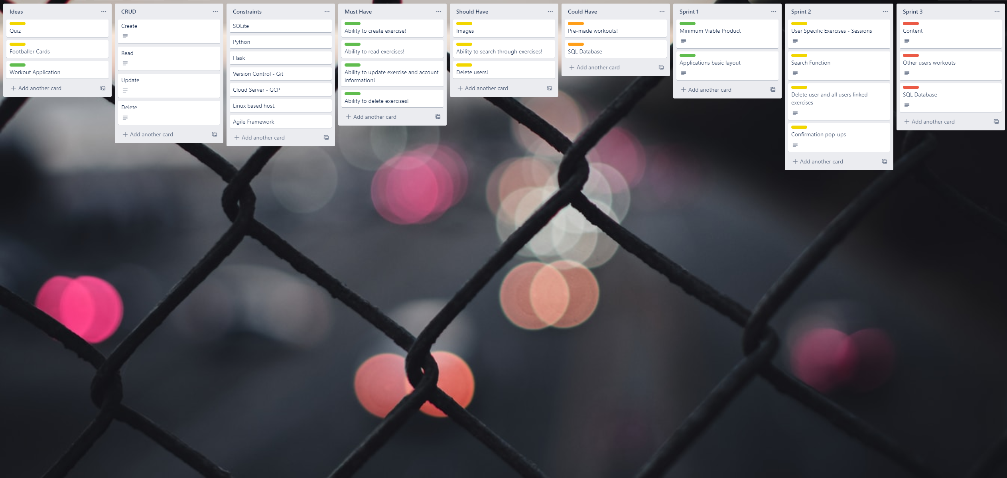
Trello Board

Slide 10
Next Sprint
Content
Ability to choose other users' workouts
MySQL Database
During the next sprint I would like to fill out the application with more content.
I’d also like to alter the design of the website by spending more time on CSS and ultimately improving the overall presentation of the application.
I would like to implement a function that would allow users to browse other existing workouts.
The user would then be able to add the workout to their own personal account.
I would like to have more time to look into deploying the database using MySQL as an instance within GCP as this would allow for the database to scale on request.
Investigation into converting a SQLite database into a MySQL database is needed.

Slide 11

Image SLide
Any questions?

Slide 12
THANK YOU
WOODGROVE BANK

